Slide 1
Customer Insights Case Study
Presented by: Altamash Khan
Date: 12/05/2024

Slide 2
Objectives & Background
Data is provided for Customer transaction
Aim is to produce meaningful insights for the CEO
Data is limited from 2009 to 2010

Slide 3




Methodology
Transformations in Excel
Data Analysis Insights

Slide 4
Data Preparation and assumptions
There are negative entries for quantity column even though order is not of type cancelled the assumption is to fix the past records
While importing data in SQL and power bi, Date has been converted to short date because for all the analysis I have done time stamp was not required.
There are records where customer id and product description is not given which decreases the quality of the data
For analysis I have combined the data of both sheets into one table.

Slide 5
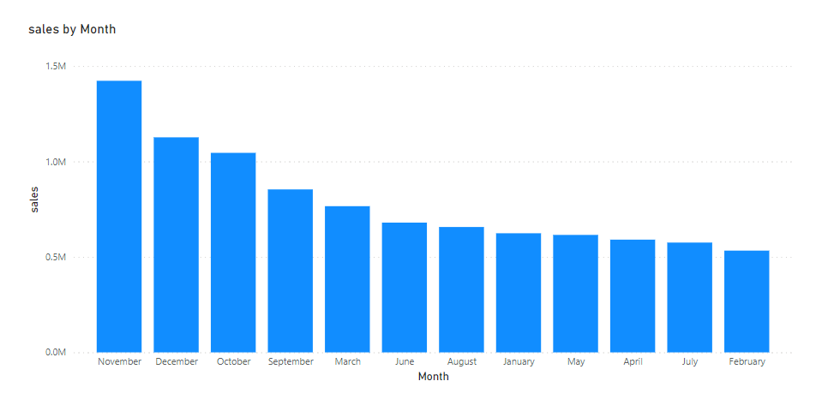
Insight 1: Seasonality
Observation: It is observed that the sales is happening highest in the month of November, December, October i.e. last quarter and lowest in February month
Year 2010

Slide 6
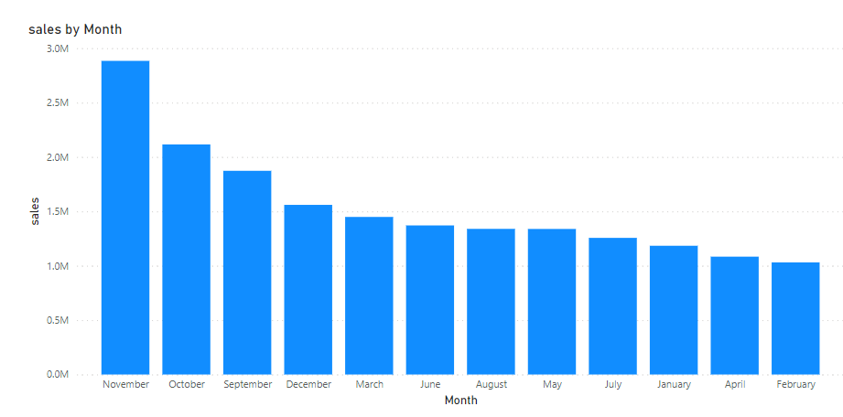
Insight 1: Seasonality
Year 2010 and 2011 Combined

Slide 7
Insight 1: Recommendations
Strategic Inventory Management: Ensure adequate stock levels and minimize excess inventory to meet heightened demand efficiently.
Targeted Marketing Campaigns: Launch focused advertising and promotions to capture consumer attention and drive sales during peak months.
Clearance sale in the month of February: To promote customer to shop more during this period on discounts

Slide 8
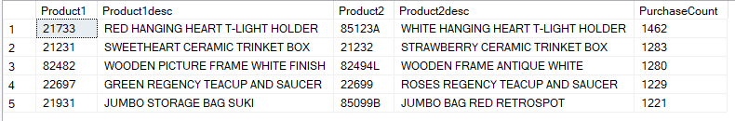
Insight 2: Top five products that are sold together
Observation: There are few products pairs which are constantly bought together
* This result is calculated considering whole data set, 2009 to 2011

Slide 9
Insight 2: Recommendations
Bundle Deals: Create bundled packages that include the frequently paired products, offering customers a convenient option to purchase both items together at a discounted price.
Cross-Selling Strategies: Train sales teams to recognize patterns of paired purchases and actively suggest complementary products to customers during the buying process.
Customized Recommendations: Implement recommendation algorithms on e-commerce platforms or in-store displays to suggest the complementary product when customers add one of the paired items to their cart or express interest in a particular product.

Slide 10
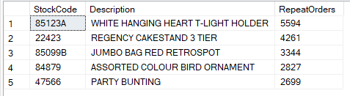
Insight 3: Top five products with most repeat orders
Observation: These are the top five products which have the most Repeat orders
* This result is calculated considering whole data set, 2009 to 2011

Slide 11
Insight 3: Recommendations
Customer Loyalty Programs: Implement loyalty programs that offer incentives or rewards for repeat purchases of the top five products, encouraging customers to continue buying them.
Subscription Services: Offer subscription options for the top five products, allowing customers to schedule regular deliveries and ensuring a steady stream of repeat orders.

Slide 12
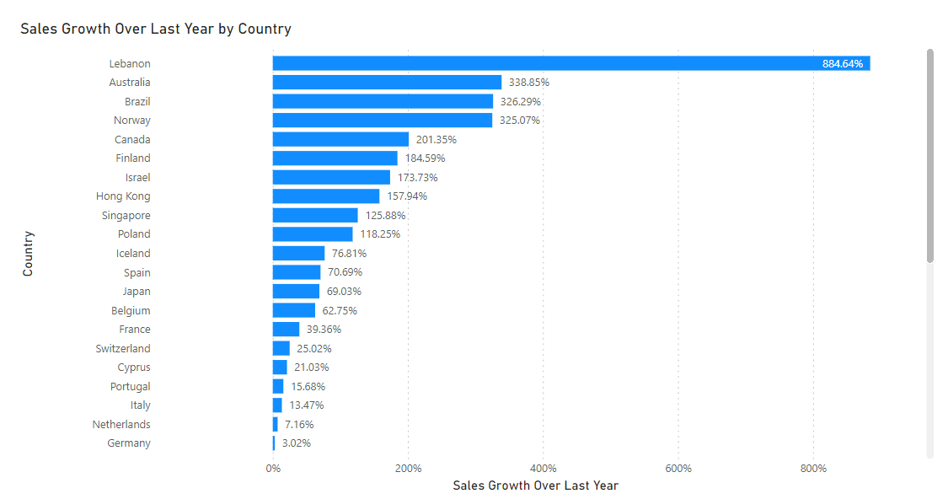
Insight 4:Winners and Bleeders Countries
Observation: Countries with positive growth over last year’s are winners and negative growth over last year’s are bleeders
Winners for 2011
* Countries having sales in both the years 2010 and 2011 are considered

Slide 13
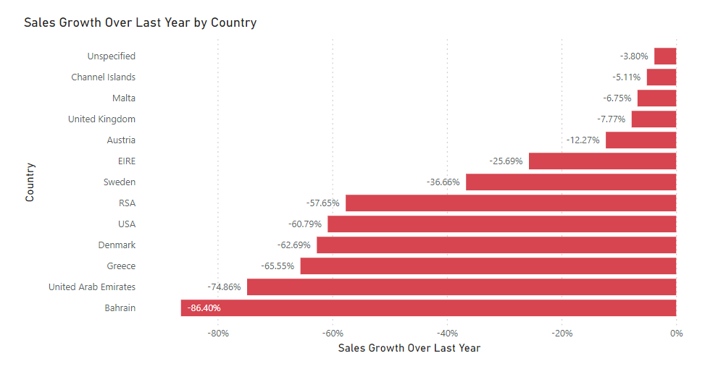
Insight 4:Winners and Bleeders Countries
Bleeders for 2011
* Countries having sales in both the years 2010 and 2011 are considered

Slide 14
Insight 4: Recommendations
Investment Opportunities: Promote investment opportunities in "winning" countries to attract foreign direct investment (FDI) and stimulate further economic growth, emphasizing the favorable business climate, infrastructure development, and potential for high returns.
Support for Bleeders: Provide targeted assistance and support to countries experiencing negative growth ("bleeders") through development aid, technical assistance programs, and capacity-building initiatives aimed at addressing underlying economic challenges and fostering sustainable recovery.

Slide 15
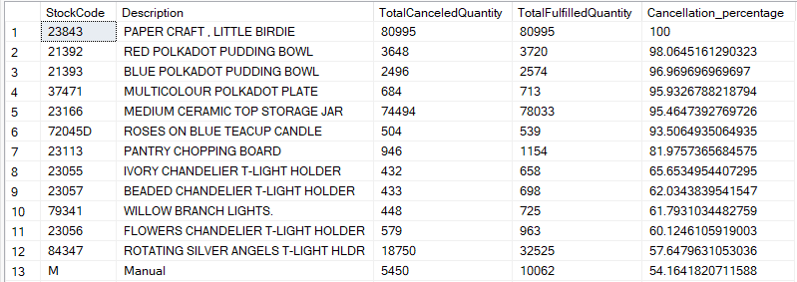
Insight 5: Products with High cancellation rate
Observation: There are products with cancellation rate more than 50%
* Products with fulfilled quantity greater than 500 are only considered
*This result is calculated considering whole data set, 2009 to 2011

Slide 16
Insight 5: Recommendations
Root Cause Analysis: Conduct a thorough analysis to identify the underlying reasons for the high cancellation rate, such as product defects, poor customer experience, or unclear product descriptions.
Improvement Initiatives: Implement targeted improvement initiatives to address the identified root causes, which may include product redesign, quality control measures, or enhancements to the ordering process.
Customer Feedback Mechanisms: Establish effective feedback mechanisms to gather insights from customers who cancel orders, enabling the company to understand their concerns and preferences better and make necessary adjustments.

Slide 17
Thank you

